Slide 1
Minimum Spanning Tree
Md Mehrab Hossain Opi

Slide 2
Tree
A special kind of graph that contains no cycle.
Two vertices are connected by only one path.
A tree with N nodes has exactly N-1 edges.

Slide 3
Subgraph
A graph derived from another graph by
Taking a subset of vertices.
Taking a subset of edges.

Slide 4
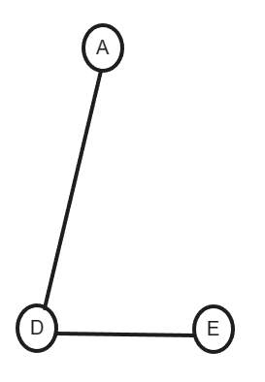
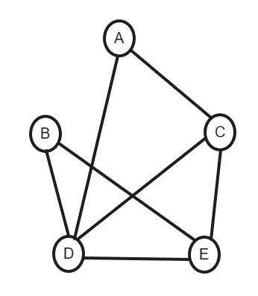
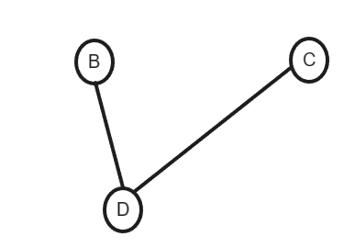
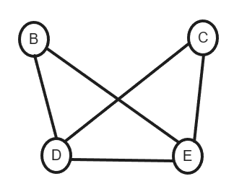
Subgraph

Slide 5
Spanning Tree
A subgraph of graph G that
Contains all the vertices of G.
Edges connects all the vertices without any cycle.

Slide 6
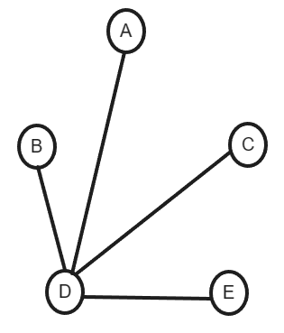
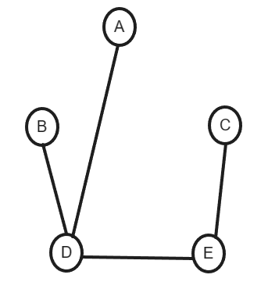
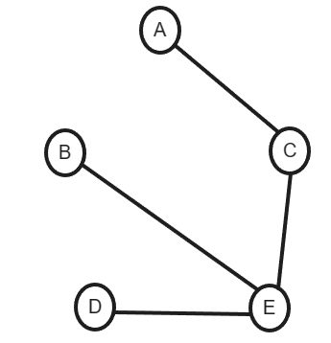
Spanning Tree

Slide 7
Minimum Spanning Tree
A graph might have multiple spanning tree.
Consider weighted graph now.
Let us define the cost of a spanning tree as the sum of weights of the edge.
As the name speaks Minimum Spanning Tree (MST) is a spanning tree with minimum cost.

Slide 8
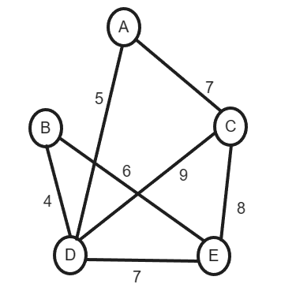
Minimum Spanning Tree

Slide 9
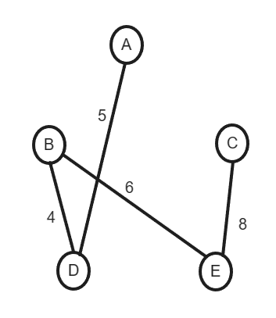
Minimum Spanning Tree

Slide 10
Algorithms to find MST
Two popular algorithms
Prim’s Algorithm
Kruskal’s Algorithm
We will focus on Prim’s Algorithm today.

Slide 11
Prim’s Algorithm
Finds minimum spanning tree for a
Weighted
Undirected graph.
A greedy algorithm
Does not work for directed graph.

Slide 12
Prim’s Algorithm
Starts with an arbitrary node.
Repeatedly adds edge with minimum weight.
Edges should not create cycle.

Slide 13
Prim’s Algorithm (Working Procedure)
Initialization
Choose a starting vertex (S) as initial MST.
Initialize a data structure to store the edges to consider.
We consider edge with minimum weight.
Set / Priority Queue.
Initialize a data structure to keep track of vertex added in the MST.
A visited array / vector.

Slide 14
Prim’s Algorithm (Working Procedure)
Selecting Edge
Find the minimum weight edge that connects a vertex in the current MST to a vertex outside the MST.
Consider the edges adjacent to vertices in the MST.

Slide 15
Prim’s Algorithm (Working Procedure)
Adding Vertex and Edge
Once the minimum-weight is found, add the associated vertex and edge to the MST.
Mark the newly added vertex as part of the MST.

Slide 16
Prim’s Algorithm (Working Procedure)
Repeat
Repeat step 2 (Selecting Edges) and step 3 (Adding Vertex and Edge) until all vertices are part of the MST.

Slide 17
Prim’s Algorithm (Example)

Slide 18
Prim’s Algorithm (Example)
Consider 6 as the initial MST.

Slide 19
Prim’s Algorithm (Example)
Find the minimum-weighted usable edge in the MST .

Slide 20
Prim’s Algorithm (Example)
It’s (6,7) with cost 1.

Slide 21
Prim’s Algorithm (Example)
Add (6,7) in the MST. Mark 7.

Slide 22
Prim’s Algorithm (Example)
Find the minimum-weighted usable edge in the MST .

Slide 23
Prim’s Algorithm (Example)
It’s (6,8) with cost 2.

Slide 24
Prim’s Algorithm (Example)
Add (6,8) in the MST. Mark 8.

Slide 25
Prim’s Algorithm (Example)
Add (8,4) in the MST. Mark 4.

Slide 26
Prim’s Algorithm (Example)
Add (4,5) in the MST. Mark 5.

Slide 27
Prim’s Algorithm (Example)
Add (5,1) in the MST. Mark 1.

Slide 28
Prim’s Algorithm (Example)
Add (1,2) in the MST. Mark 2.

Slide 29
Prim’s Algorithm (Example)
Next min-cost edge is (4,2) with cost 8.

Slide 30
Prim’s Algorithm (Example)
The edge creates a cycle in the MST. Hence discard it.

Slide 31
Prim’s Algorithm (Example)
Similarly edge (1,4) and (7,4) also creates cycle.

Slide 32
Prim’s Algorithm (Example)
So next usable edge is (4,3).

Slide 33
Prim’s Algorithm (Example)
All the nodes have been added in the MST.

Slide 34






Prim’s Algorithm (Example)
Final MST.

Slide 35
Complexity of Prim’s Algorithm
In our implementation
A priority queue will be used.
Edges will be inserted in the priority queue.
Insertion in priority queue takes O(log N) time, Here it will be O(log E).
Removing element takes equal time.
Element can be removed E times.
Total complexity – O(E log E).

